Slide 1
INFOSYS SPRINGBOARD • VIRTUAL INTERNSHIP 7.0
SUPPLY CHAIN VISIBILITY SYSTEM WITH OPTIMIZATION ANALYTICS GROUP 1
80,519
SUPPLY CHAIN RECORDS
An Interactive Power BI Dashboard for Supply Chain Performance Analysis
17.83%
54.82%
ON-TIME
LATE
Team Members:
Uppala Bhavya Sri
V. Charita Sree Velpuri Sai Rohitha
|Venkata Puneeth Kothapalli |
Yuvasree P Team D • Group 1 Mentor: Ms. Nityasree
POWER BI
ANALYTICS • VISIBILITY • INSIGHTS

Slide 2
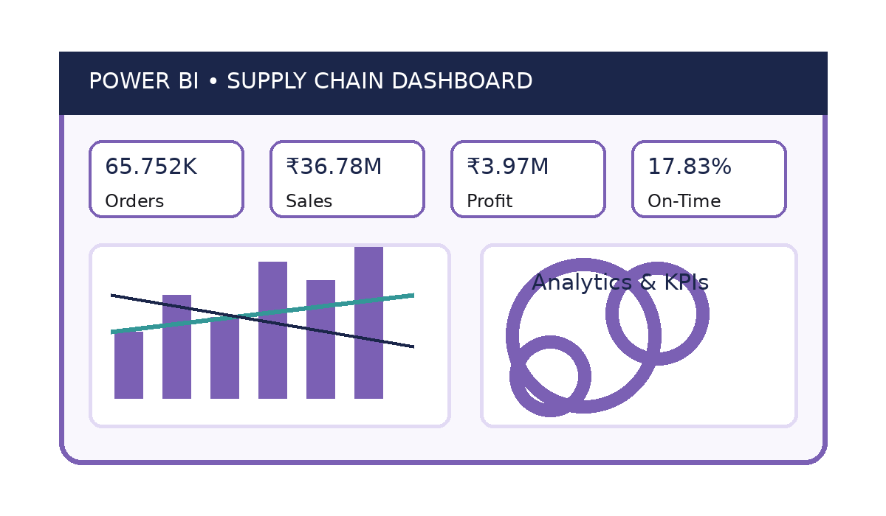
PROJECT OBJECTIVE
02
Project Objective
• Transform raw supply chain data into meaningful visual insights.
• Analyze sales, orders, customers, products and delivery operations.
• Evaluate geographic markets, costs, discounts and profitability.
• Develop interactive Power BI dashboards for data-driven decisions.
Project Modules
Sales & Delivery Analysis • Customer & Product Insights
Geographic & Market Performance • Cost & Profitability
Order Value & Performance Insights

Slide 3






Project Execution Details
WORKFLOW DIAGRAM
pg. 30
PROJECT EXECUTION MILESTONES
03
Milestone 1 – Data Acquisition & Cleaning
Problem Understanding
Studied the DataCoSupplyChainDataset and prepared the data using Power Query.
Data Collection
Data Understanding
Milestone 2 – Data Modeling
Structured the data and created DAX measures for sales, profit, orders, customers and delivery.
Data Connection
Milestone 3 – Development
Data Preproccessing
Built interactive Power BI dashboard pages using suitable analytical visuals.
Data Analytics
Data Modeling
Milestone 4 – Review & Optimization
Validated calculations and improved dashboard readability, consistency and usability.
Data Visualisation
Share and Publish

Slide 4
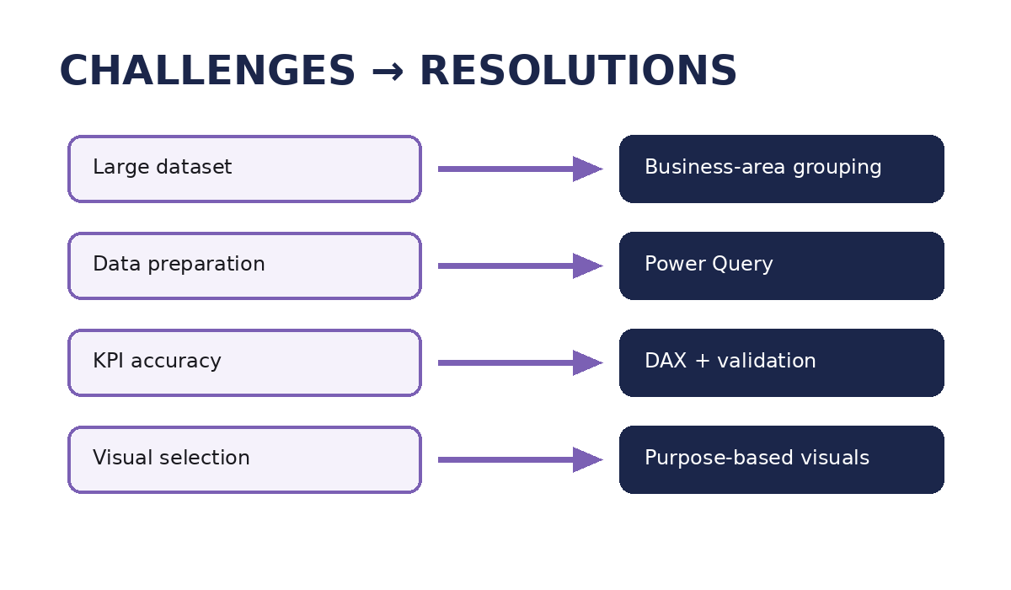
CHALLENGES & RESOLUTIONS
04
Challenges
• Understanding a large dataset with approximately 80,519 records.
• Preparing and transforming raw data accurately.
• Creating accurate KPIs and DAX measures.
• Selecting suitable visuals without unnecessary repetition.
• Maintaining dashboard layout, readability and consistency.
Resolutions
• Grouped fields by business area and used Power Query for preparation.
• Created and validated DAX measures against the dataset.
• Selected visuals according to analytical purpose and organized pages systematically.

Slide 5
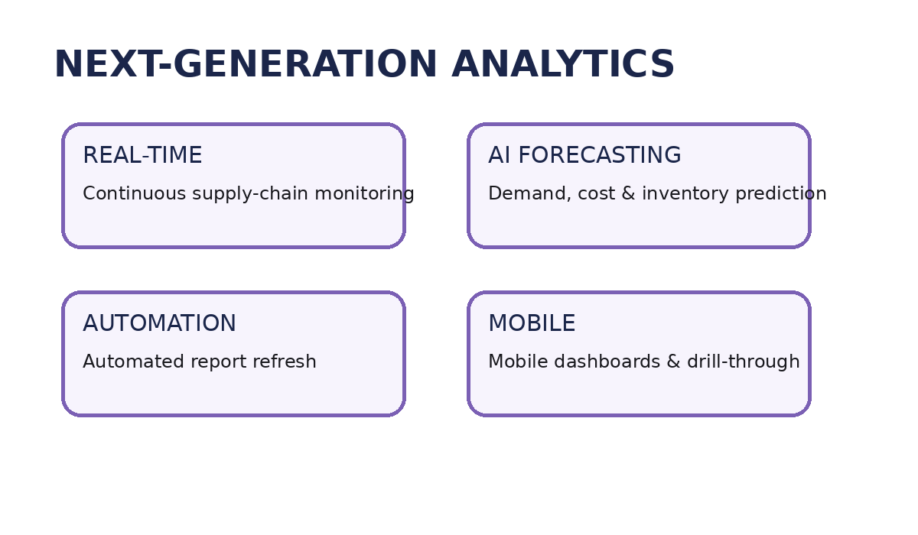
FUTURE ENHANCEMENTS & KEY INSIGHTS
05
Future Enhancements
• Integrate real-time supply chain data.
• Add AI-based forecasting and predictive analytics.
• Implement automated report refresh.
• Develop mobile-friendly dashboards and drill-through reports.
Key Insights
• On-Time Delivery Rate: 17.83% | Late Delivery Rate: 54.82%
• Total Customers: 20,652 | Average Profit per Order: ₹21.98
• Europe contributes approximately ₹10.87M in sales.

Slide 6
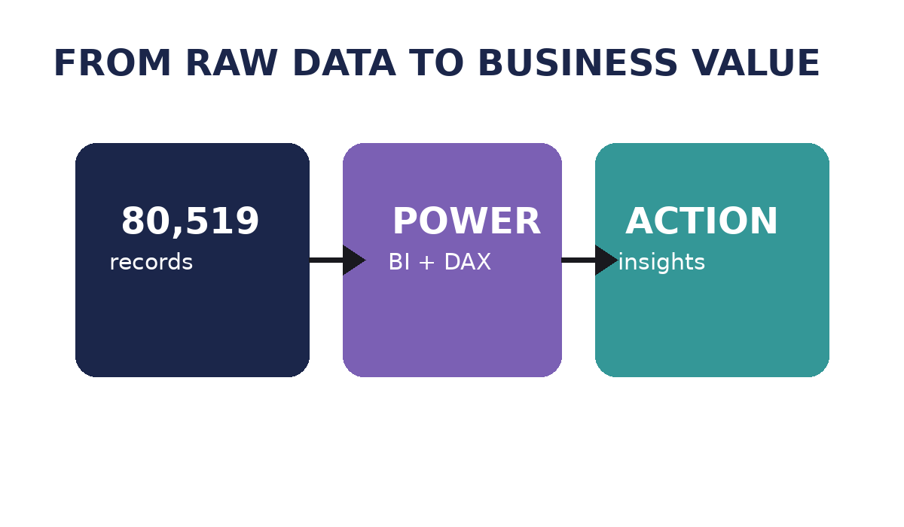
CONCLUSION
06
Supply Chain Visibility and Optimization successfully transformed the DataCoSupplyChainDataset into an interactive Power BI dashboard covering sales, customers, products, delivery, geography, costs and profitability.
Technical Skills
Soft Skills
• Microsoft Power BI
• Power Query Editor
• Problem Solving
• Analytical Thinking
• DAX & Data Modeling
• Data Visualization
• Communication
• Teamwork
• Business Intelligence
• Microsoft Teams
• Presentation
• Time Management
• GitHub
• GitLab
Infosys Springboard – Virtual Internship 7.0

Slide 7
ACKNOWLEDGEMENTS & REFERENCES
07
Acknowledgements
References
We sincerely thank the Infosys Springboard Team for providing this enriching virtual internship and a structured platform for gaining practical industry experience.
We express our heartfelt gratitude to our mentor, Ms. Nityasree, for her continuous guidance, valuable feedback, and encouragement throughout the project.
We also thank our team members for their collaboration, communication, and shared efforts in successfully completing the project.
We acknowledge Microsoft Power BI documentation and community resources, along with Kaggle, for providing valuable learning resources and datasets that supported our dashboard development and analysis.
Overall, this internship strengthened our technical, analytical, teamwork, and problem-solving skills and provided valuable practical experience in data-driven decision-making.
• DataCoSupplyChainDataset
• Microsoft Power BI Documentation
• Power BI Community Resources
• Kaggle Dataset Resources
• Infosys Springboard Learning Materials
• Microsoft Power Query & DAX resources

Slide 8
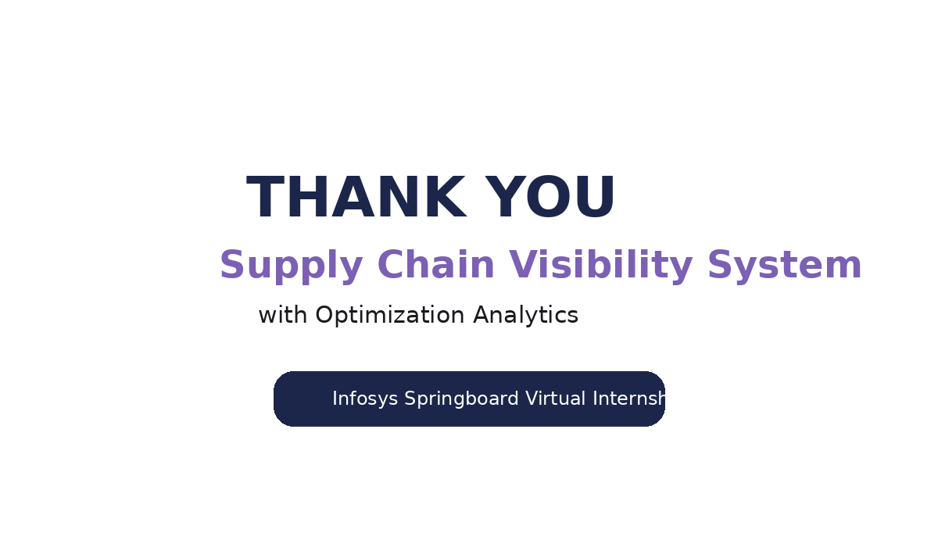
THANK YOU

